Slide 1
Introduction to
THE
Military and Veterans Rights Bureau (MVRB)
Shannon Yount, Program Specialist
Military and Veterans Rights Bureau
Notes:
Hello, my name is Shannon Yount and I am with the Office of the Illinois Attorney General. This presentation will provide an overview on the Military and Veterans Rights Bureau and the rights of veterans within the State of Illinois.
A little bit about myself prior to discussing the bureau and your rights as a veteran.
I am the Program Specialist within the Military and Veterans Bureau and I have been with the bureau since 2018. I served in the Marine Corps for more than seven years as a combat correspondent and held many positions such as area guardsman, sexual assault victim advocate and suicide prevention training NCO.
During my time in the Marine Corps, I deployed to Afghanistan where I was imbedded with various units. My favorite was covering stories on combat engineers and combat surgeons. I utilize my military experience and years of working in the veteran community every day while with the Office of the Illinois Attorney General.

Slide 2
AGENDA
An introduction to the Military and Veterans Rights Bureau (MVRB)
An overview of scams targeting veterans
An overview of your rights as a veteran
Ways to contact the bureau
Notes:
During the presentation, I will conduct an overview of the Military and Veterans Rights Bureau, scams targeting veterans, rights as a veteran and the many ways to contact us for assistance.

Slide 3
Military Veterans Rights Bureau
(MVRB)
The only Bureau like it in the Country
Everyone has been a part of the military community.
VA Accreditation is a requirement
Notes:
Just a little background on the bureau . . . IL appears to be the only AG’s office in the country that has an entire bureau dedicated solely to addressing the concerns of service members, veterans and their families. There are four attorneys .. .. .. one programs specialist , a military and veterans advocate and an administration clerk assigned to the bureau. All four of those attorneys . . . and the Program Specialist . . . are veterans. Two of those attorneys are military retirees. The third attorney is currently serving as a JAG officer in the Reserves. The fourth is currently serving as a JAG officer in the National Guard. ALL FOUR of those attorneys AND the Program Specialist are VA Accredited . . . The Military and Veterans Advocate and Administration Clerk have been apart of the military community. SO, I think it would be fair to say that . . . collectively, at least, .. .. .. we are pretty well versed in service member and veteran related matters and concerns . . .
Inside that bureau, the attorneys are assigned to specific areas of law that pertain to the veteran/military community.

Slide 4
Mission
The Military and Veterans Rights Bureau works to ensure Illinois service members, veterans, their families, and their survivors receive every right, benefit and protection mandated by both State and Federal Law, that they have earned for their service to their country, their state and their community.
Notes:
Seems like a lot to cover for one bureau, but we are passionate about serving veterans, service members and dependents.

Slide 5
Education and Outreach
Provide Resource Information
Attend veteran-related events
Resource Fairs
Annual Conventions
Conduct Presentations
Notes:
One of the ways we strive to meet our mission is with education.
We publish material that provides information to the military community. This allows us to educate members of the community about their rights and how to obtain eligible benefits.
Education also consists of getting out into the communities of Illinois and educating citizens. Either by staffing resource tables or conducting presentations. Such as what I am doing right now. We also have a resource table staffed for this event.
Upon request, members of the bureau can conduct presentations and attend community events. All you have to do is call the Helpline at 1-800-382-3000 or email MVRB@ilag.gov.

Slide 6
Educational presentations for the military community
1. MVRB overview
2. Service member employment rights
3. Veteran consumer rights
4. Veteran Assistance Oversight
5. State Charter
Notes:
As I said, the bureau conducts a variety of presentations to ensure awareness of your rights and benefits. We offer five that are for the military community.
We are about to kick off the second series of a webinars for this year. If interested, please visit the OAG resource table and sign up for announcements.

Slide 7
Topics covered in a Service member
Employment Rights presentation
Reemployment
Differential and Concurrent Pay
Employment benefits
Notes:
Topics covered in a Service member Employment Rights presentation include
A breakdown of the state law that provides employment and reemployment rights. The resources available to service members and employers on the website.

Slide 8
Topics covered in a Veteran Consumer presentation
Phishing Scams
Pension Advance Loan Scams
VA Benefits Scams
Notes:
Topics covered in a Veteran Consumer presentation include
The various types of scams and how to protect oneself from being a victim.
I recommend attending the presentation that is slated next month during Military Consumer month.

Slide 9
Topics covered in a Veteran Assistance Oversight presentation
Veterans Assistance Commission Structure
Duties and Responsibilities of Delegates and Alternates
Duties and Responsibilities of a Superintendent
Duties and Responsibilities of the County
Notes:
Topics covered in a Veteran Assistance Oversight presentation include
the structure of a VAC
the duties and responsibilities of delegates and alternates on a commission
the duties and responsibilities of a superintendent
and the duties and responsibilities of the county

Slide 10
Topics covered in a State Charter
presentation
Effective date of act
Who can apply for State Charter status
Location of application for State Charter
Notes:
Topics covered in a State Charter presentation include
the effective date of the State Charter Act
who can apply
location of the application on the Military Veterans Assistance Act and State Charter subpage.

Slide 11
Publications
Notes:
Earlier I mentioned material, these two guides are maintained and published by the Office of the Illinois Attorney General.
The Benefits for Illinois Veterans book provides information pertaining to federal, state and local benefits. The Legal Rights of Illinois Service Members book provides information pertaining to laws benefitting service members and veterans.

Slide 12
Brochures
Notes:
Along with the books, there are several brochures available for citizens. They provide useful information from military leave, consumer scams, veteran employment preference, and Military trauma.
All of this material is readily available on the Military and Veterans Rights webpage.
I keep mentioning that all of this useful information is available on the internet, but what is the best way to locate it?

Slide 13
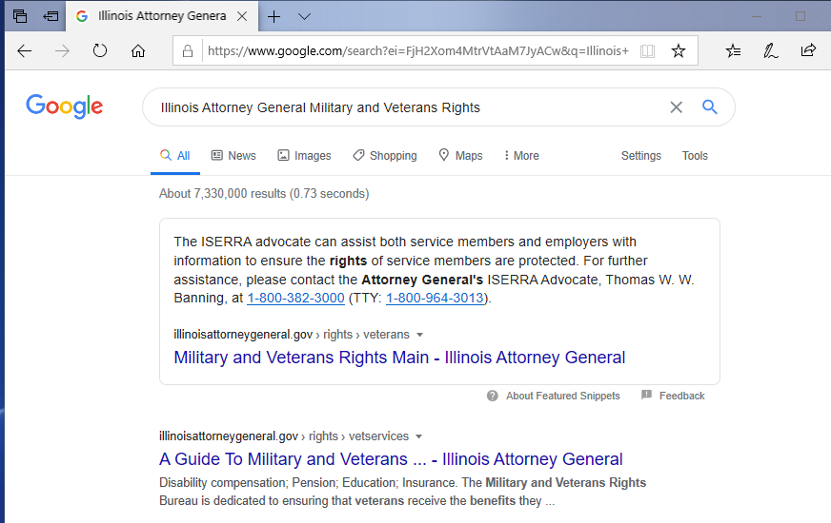
Our webpage
Notes:
Locating the Official webpage of the Illinois Attorney General, Military and Veterans Rights Bureau is as simple as a Google Search. In the search bar, type “Illinois Attorney General Military and Veterans Rights”. As you can see, it is the first link provided and individuals do not have to click on the webpage to locate the Helpline number. The Helpline is available to seek assistance, information and to file a complaint.

Slide 14
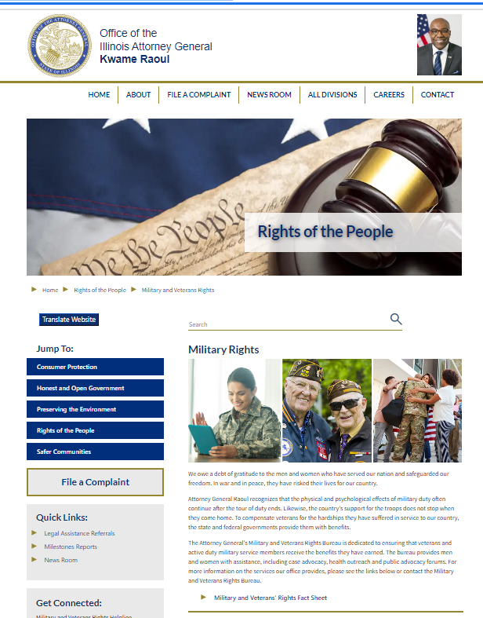
How to ask for help
In-person
Online
Telephone
Notes:
Here is what the Military and Veterans Rights main page looks like. All of the MVRB material is on this page. Too include the Request for Assistance form, which is located in the center of the webpage. Individuals can also seek assistance by calling the Helpline at 1-800-382-3000, sending an email to MVRB@ilag.gov or stopping by one of the many offices.
Many of you are wanting to know what things could you seek assistance or information from the bureau. An individual could file a complaint with the bureau if they believe an entity is not Military Veterans Assistance Act complaint. A veteran could file a complaint pertaining to a business filing claims for veterans and they are not VA accredited.
A surviving spouse could seek assistance from the bureau in obtaining proper documentation to apply for a Federal or state benefit. Not many people know that individuals can seek records from vital records free of charge if they are utilizing the documents for applying for benefits.

Slide 15
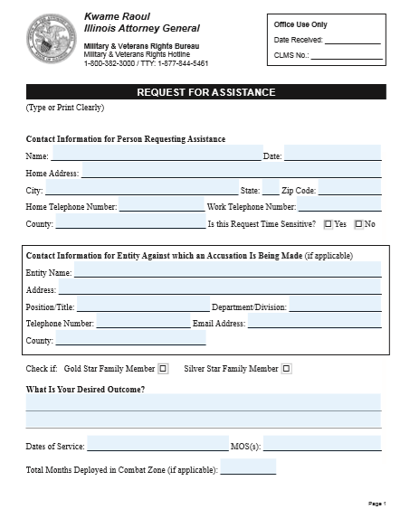
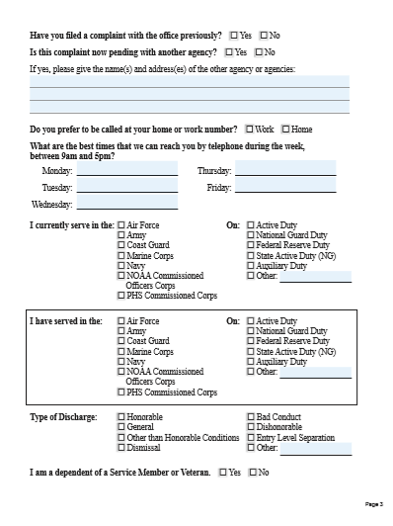
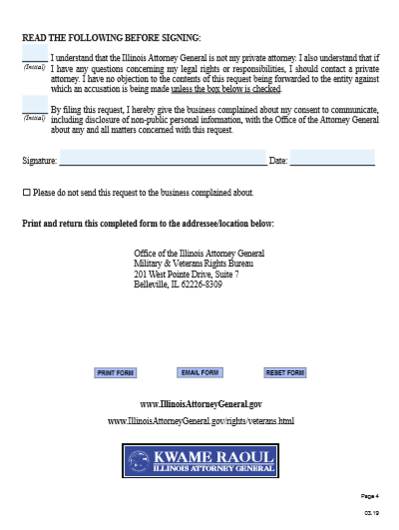
Requesting assistance
Notes:
The most effective way to seek information or file a complaint with the bureau is to complete and submit a Request for Assistance form, which only consists of four pages.

Slide 16
What happens after a Request For Assistance (RFA) is submitted to the MVRB?
1. The form will be reviewed
2. A member of MVRB will communicate with individual on request and go over options.
3. MVRB will provide information, informally mediate or refer to appropriate resource.
Notes:
So you sent the form and you wonder, What Now?
That is a great question, members of the bureau will review the RFA to determine if the bureau can assist or if the complaint will need to be referred to another agency.
If the complaint or concern meets the criteria for assistance with MVRB, the next step is informal mediation. A member of the bureau will send a copy of the complaint, along with a letter from the Office of the Attorney General, to the entity or person complained about. Informal mediation is not legal representation. The Attorney Generals Office does not represent individuals, they protect the public interest of Illinois residents.

Slide 17
Enforcement
“Public Interest” responsibilities (common law)
Service member rights and protections under the Illinois Service Member Employment & Reemployment Rights Act (ISERRA) 330 ILCS 61
Service member rights and protections under the Illinois Service Member Civil Relief Act (ISCRA) 330 ILCS 63
Illinois residents and businesses victimized by fraud, deception and unfair business practices under the Illinois Consumer Fraud and Deceptive Business Practice Act 815 ILCS 505
Military Veterans Assistance Act 330 ILCS 45
Notes:
If informal mediation is unsuccessful, the issue can be escalated to enforcement and investigations.
MVRB enforces service members and veteran rights and protections under a number of different umbrellas, here are just a few.
Illinois Service Member Employment and Reemployment Rights Act
Illinois Service Member Civil Relief Act
Illinois Consumer Fraud and Deceptive Business Practice Act
And Military Veterans Assistance Act
Just because it is not listed above, does not mean we can not help. We encourage individuals to contact us and talk to us about their issues or concerns.

Slide 18
Advising and representing the Attorney General
1. Advise internally on various military & veteran related issues
2. Review proposed legislation
3. Monitor trends
PACT ACT G.U.A.R.D. VA Benefits Act
4. Attend events and meetings
Give Presentations and Provide Resources
5. Appointments to committees
Notes:
When the bureau receives a series of complaints or identifies a trend that negatively affects the veteran/military community. We advise the Attorney General and legislation team and propose legislation.
Due to our background, members of the bureau are tasked with legislation reviews for state bills that are entered into the Illinois General Assembly.
We assisted with the amendment to the Military Veterans Assistance Act, State Charter and recent changes to the Consumer Protection Act that addresses VA claims and nonaccredited individuals.
Our knowledge of nonaccredited entities targeting veterans is well known Nationally.
There are members of the bureau who are appointed to committees. I am the Attorney General’s appointed representative for the Illinois Veterans Advisory Council.

Slide 19
Summary
Be vigilant . . .
Research . . .
Verify . . .
And if you need assistance contact MVRB!
Notes:
In summary, use this information to stay vigilant, ask questions and to seek assistance from the Office of the Illinois Attorney General.

Slide 20
Website:
https://illinoisattorneygeneral.gov/rights-of-the-people/military-and-veterans-rights/
E-Mail:
MVRB@ilag.gov
Helpline:
(800) 382-3000
Notes:
This concludes my presentation. If you have any questions or concerns, submit a RFA from our website, send an email or call the Helpline at 1-800-382-3000.
Thank you for your time.

